Slide 1

DEPARTMENT OF MECHANICAL ENGINEERING ANNASAHEB DANGE COLLEGE OF ENGINEERING AND TECHNOLOGY, ASHTA. 2020-2021

Slide 2
PATROLLING ROBOT (B-Tech Final Year Project)
Group No. 35
Under Guidance of Mr. G.N. Rakate
Domain of Project: Robotics

Slide 3
PRESENTED BY :
URN No. | Name of Student
17111171 | Pratik Haribhau Rohane
17111004 | Jiganesh Ramesh Patil
17111182 | Varun Vinayak Vaidya
17111024 | Gulab Suryakant Rathod
17111184 | Ramesh Kondiba Yedage
17111183 | Swatantrya Vitthal Wadar

Slide 4

Problem Statement
Humans get tired and bored of their job and become inattentive to task.
Human Lives would be in grave danger if faced with criminal activity or any deadly occurrence during patrolling.
To avoid such damage to Human Life and Property many alternatives are explored for Patrolling Areas.
In Pandemic situation, Crowd should be avoided to handle this situation without human intervention real-time monitoring system capable of sending alerts should be proposed

Slide 5
SOLUTION SUMMARY:
Usage of Robot – Efficiency, Low-cost, Speed of performing task, decreases danger to human lives
All of the obstacles have been tackled and some of those tasks have been implemented, but this is the very first time when all of it has been brought together as one complete system.
For the Intended final result by the robot, this project is broken down to five basic important objectives.
1. Patrol in unknown environment.
2. Avoid Obstacles.
3. Detect Humans in surroundings.
4. If Humans are detected above the given threshold count
5. Alert the authority.

Slide 6

Objectives
Path Planning and Obstacle Avoidance
Human Detection
Decision Making and Alert System

Slide 7
PROPOSED IMPLEMENTATION
HARDWARE
Power Supply/ Battery charger
GPS Module
Digital Compass
Ultrasonic Sensor
Motor Driver
Arduino
Raspberry Pi & Pi Camera
SOFTWARE
GPS Module Interfacing
Digital Compass Interfacing
Ultrasonic Interfacing
Python and OpenCV

Slide 8
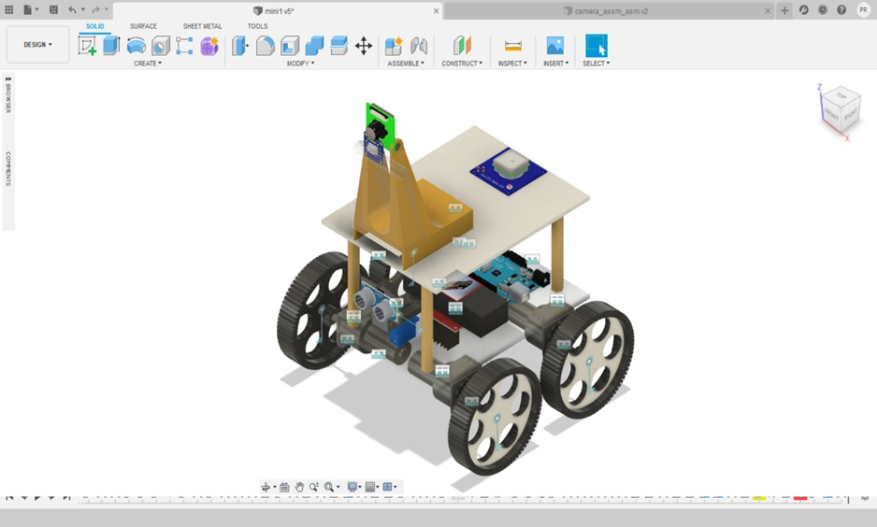
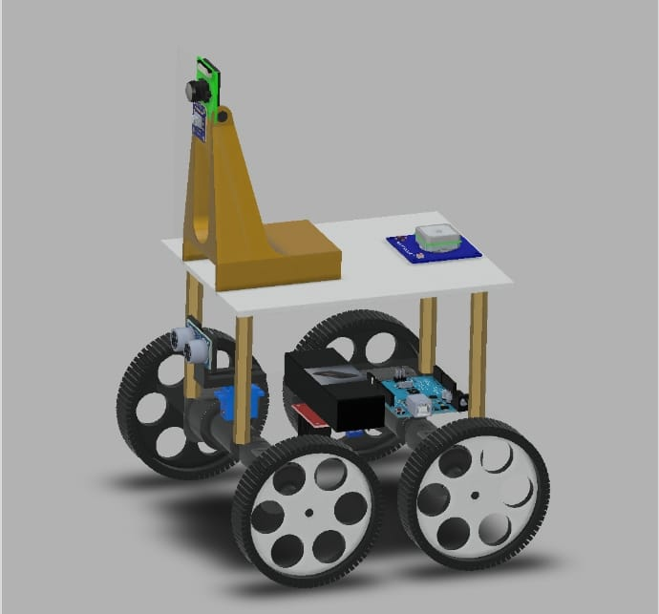
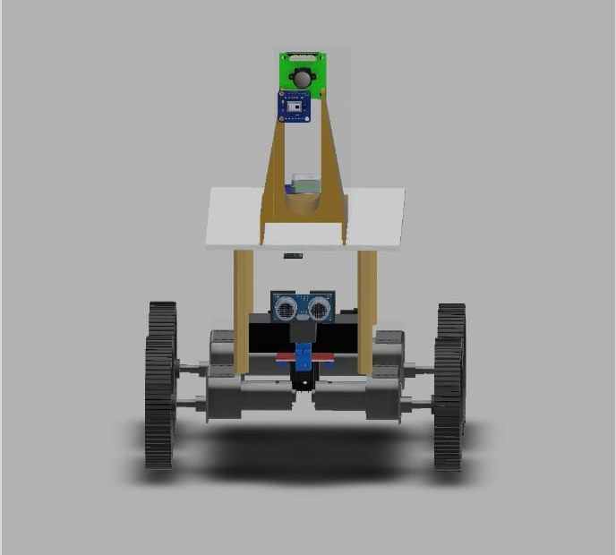
HARDWARE

Slide 9
ALGORITHM & LOGIC
Path Planning Programming Logic :
User provide the GPS coordinate destination point on the user interface.
Robot take its current GPS coordinate which are initial point of the robot.
Targeting the distance between these two points and direction.
Turn in that direction and move to the next waypoint. Trying to minimising the distance by continuous point to point steering approach.

Slide 10
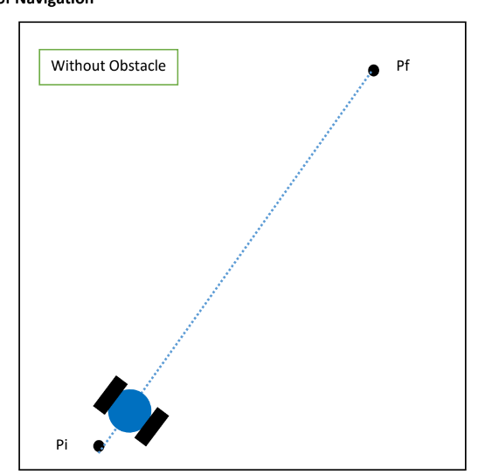
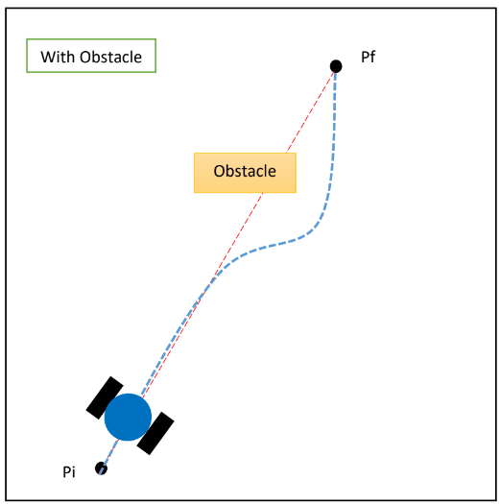
Object Avoidance
Ultrasonic Sonic sensor is at the front of the robot, which returns the distance from the object.
Object Avoidance Programming Logic :
If Obstacle is detected →
Slow done the speed
If robot moving straight >>> Find Obstacle free path.
If robot turning >>> Repeat the above step .
If robot is too close of object >>> Break, Reverse and Repeat.

Slide 11
ROS Simulation : Path Planning

Slide 12
ROS Simulation : Object Avoidance

Slide 13
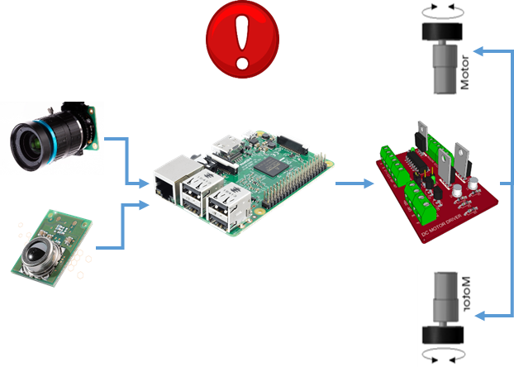
Human Detection
Detecting Human’s in frame captured by the camera.
Keeping track of the population in frame and deciding whether the place is crowded or not.
Based on the decision, alert the authority.
Required Libraries (Python)
Open CV
Inutile
Numpy
Hardware connection for Human Detection

Slide 14
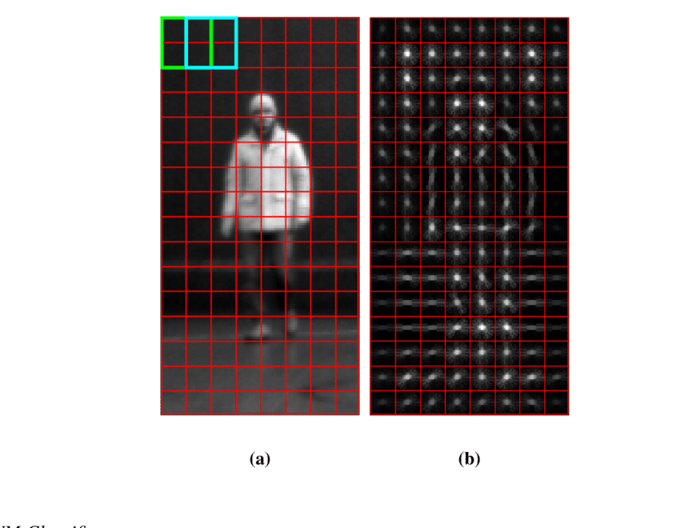
Logic for Human Detection
Programming Logic:
To elaborate good data abstraction of the human model select the descriptor methods
Using the Support Vector Machine Classifier train a detection model by setting positive and negative training images.
To remove the noise and get accurate model perform a Non-Max Suppression.

Slide 15
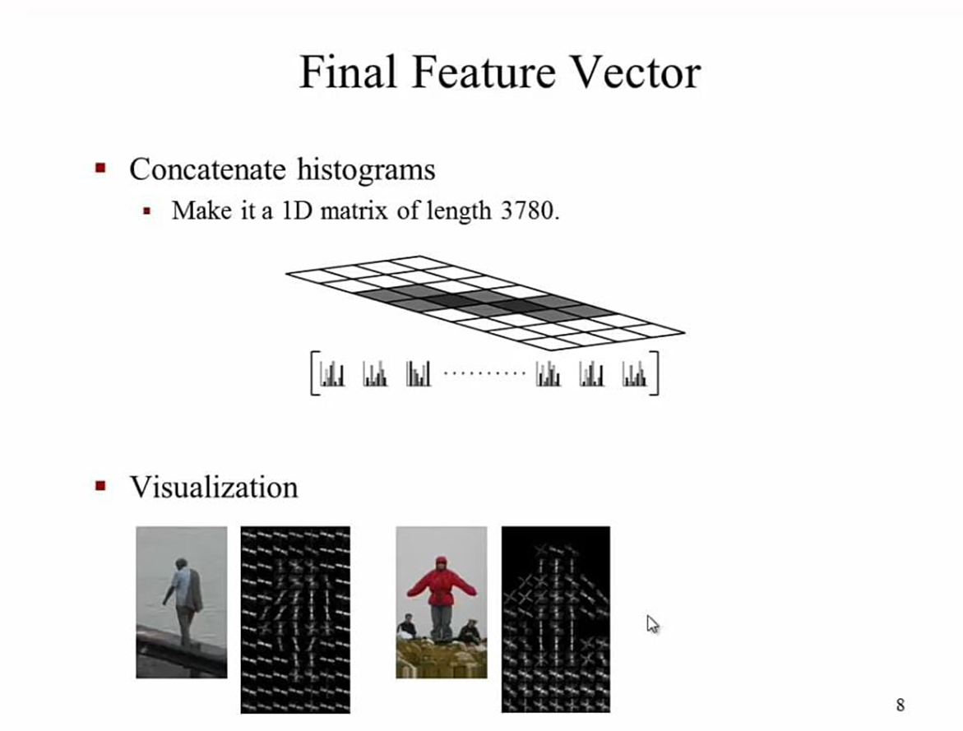
Algorithm Used for Human Detection
Histogram of Oriented Gradient
Divide image into cells
Arrows define relatively darker pixels
All pixels replaced with arrows by the algorithm
Define shape of object
Used for Human Detection
SVM classifier
Non-Max Suppression

Slide 16
Human Detection Simulation

Slide 17
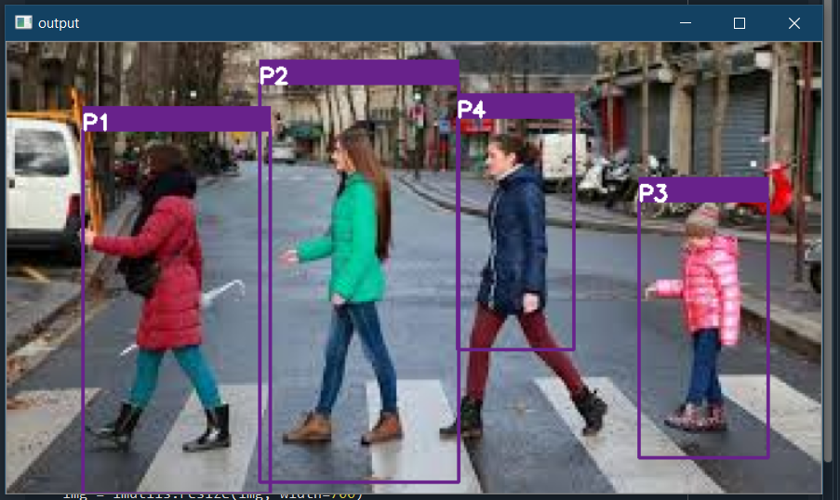
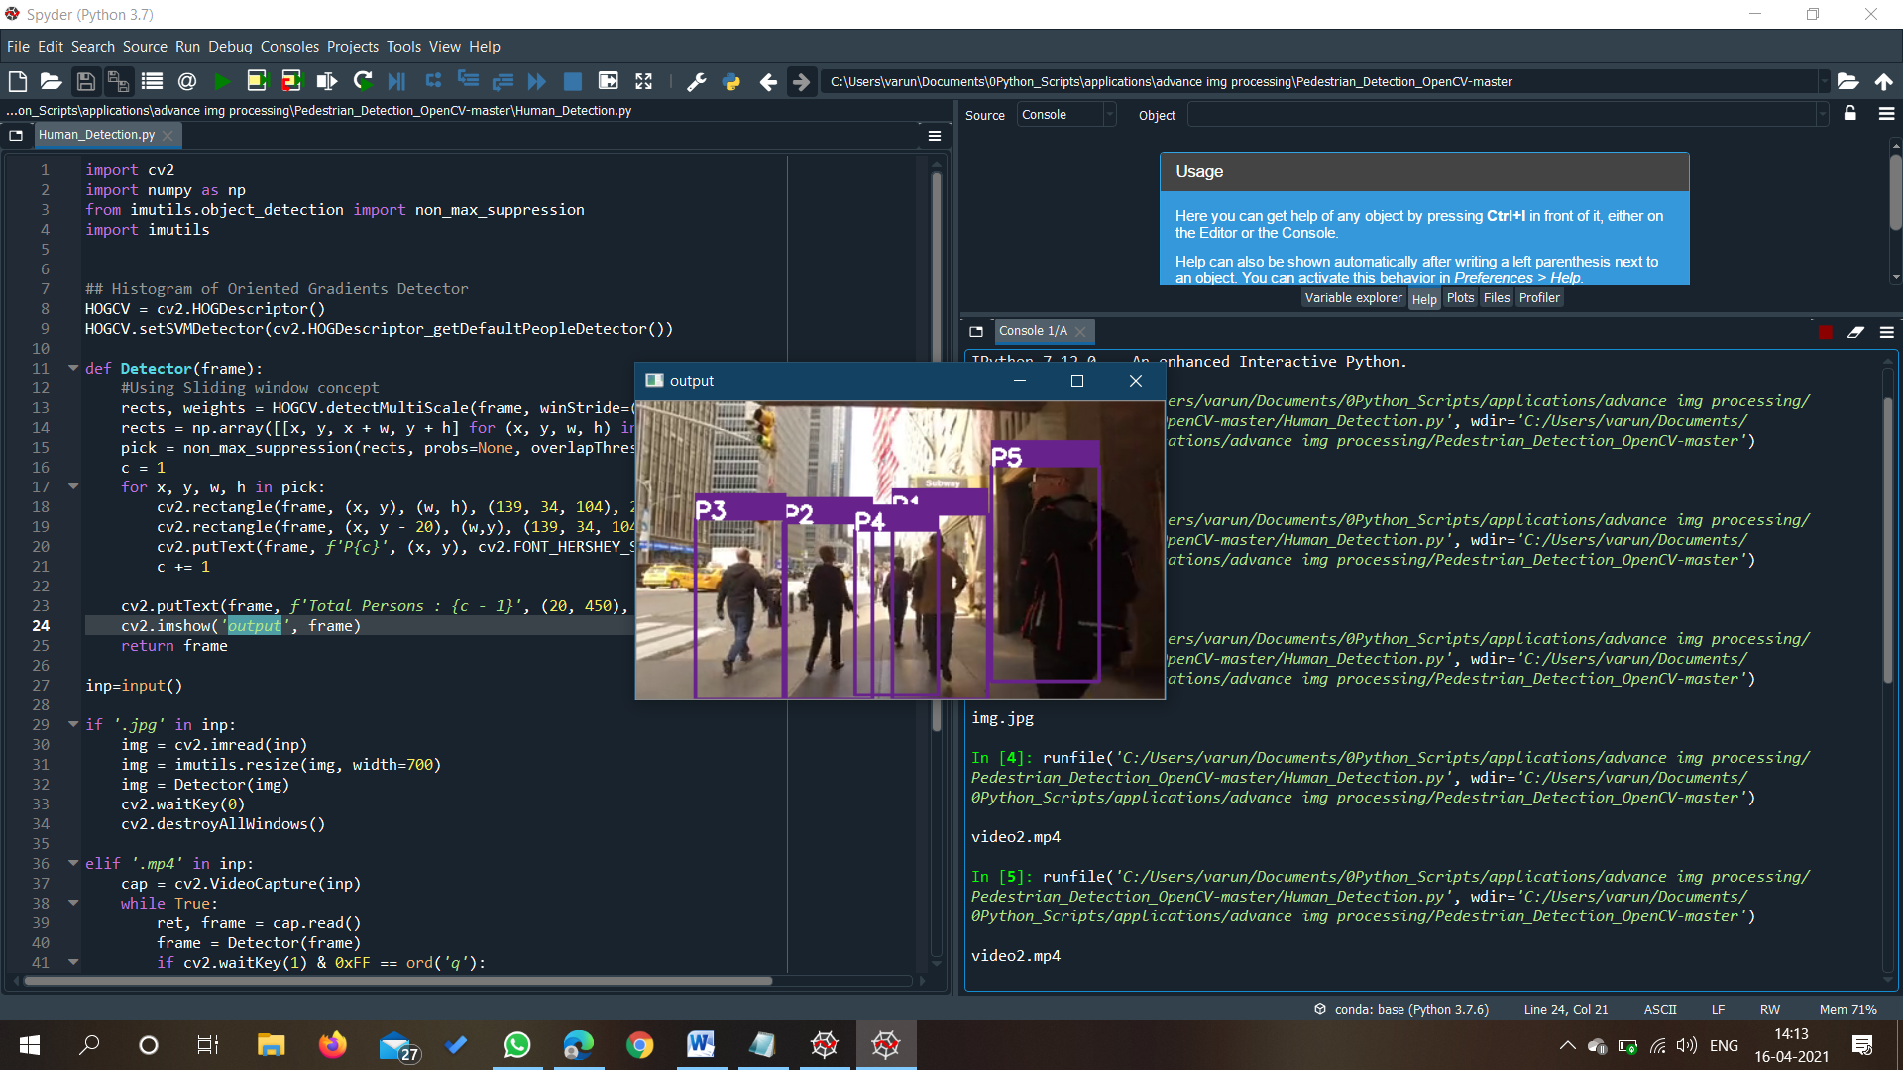
Output terminal of Human Detection Algorithm
Output of Algorithm used on an Image
Output of Algorithm used on real-time video
Alert System will be based on the threshold value of humans present.

Slide 18
FUTURE ENHANCEMENTS
Steering Mechanism for the proportional movement of wheels.
Extension of Camera for Object Detection to increase accuracy.
Web Application for user interaction with robot.
Increasing Accuracy and Range of Human Detection.
Recording Data with Patrolling Robot.

Slide 19
Research Articles
The implementation of social robots during the COVID-19 pandemic
Indoor Surveillance Security Robot with a Self-Propelled Patrolling Vehicle
A Survey on Multi-robot Patrolling Algorithms
A Review on Night Vision Robot Patrolling and Monitoring System

Slide 20
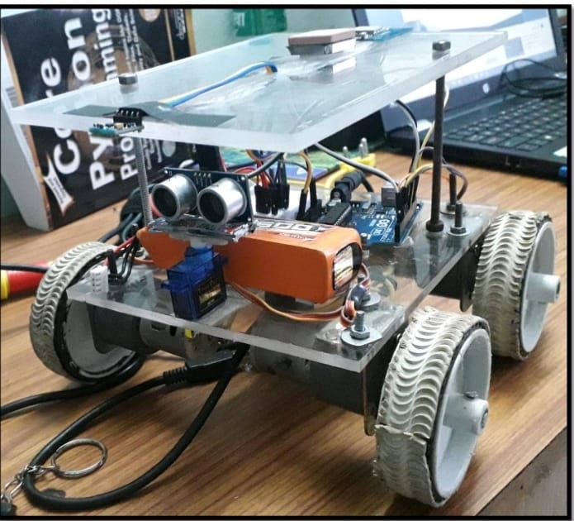
Project Implementation : Patrolling Robot

Slide 21

THANK YOU !!

